Slide 1
Web Design in-the-small Protyping issues
Franca Garzotto

Slide 2
What is inside pages?
CONTENT
+
LINKS
+
ORIENTATION INFO

Slide 3
Design in the small
Defining the data structure for the main content in the pages
Defining the way links are represented
Labels
Icons
Previews of linked objects
Defining the data structure for orientation info

Slide 4
Details about:
PAGE
Topic Page
Entry Page
Transition Page
Introductory Page
Home Page
LINK
Structural link
Transition Link
Group Link
Landmark
ORIENTATION INFO

Slide 5
< Topic name > - <Page title/ Dialogue act Name
< Fixed content: logo, payoff, banners… >
< Landmarks >
Structural link 1
Structural link 2
…
Structural link n
< Orientation info >
Dialogue act content structure
< Group links >
Page structure in the small for a Topic page

Slide 6
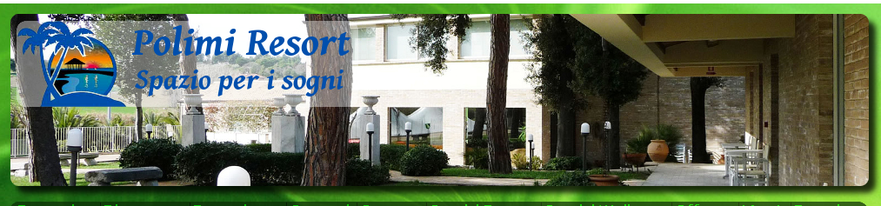
SINGLE TOPIC: The Resort; Dialogue ACTS: Our area + how to get here
< Fixed content: logo, payoff, banners… >
< Page title >
< Landmarks HOME
< Group links >
< Orientation info >
Sourroundings
Title: The sorrroundings
Short textual description (100 words) ………………………….
HOW TO GET HERE
Short textual description (100 words) ………………………….
MAP: Image
Structural link
Our events Our structures Special Offers Rooms Restaurants and Menus
Other Landmarks

Slide 7
< Kind of Topic name > - <Page title/ Dialogue act Name
< Fixed content: logo, payoff, banners… >
< Landmarks >
Structural link 1
Structural link 2
…
Structural link n
< Orientation info >
Dialogue act content structure
Transition link 1
Transition link 2
…
Transition link n
< Group links >
Page structure in the small for a Kind of Topic page

Slide 8
Multiple TOPIC Type: < Service area>; Dialogue ACT: Presentation
< Fixed content: logo, payoff, banners… >
Landmarks HOME
< Orientation info >
Fotogallery
You are in one of the «Structures» of our Resort
Structural links
4-5 Images
Title: max 30 characters
Description: Max 200 words
Orientation Info
Events hosted
here
OUR SERVICES
Service Name
+ Thumbnail Image
Service Name
+ Thumbnail Image
Transition lins
UP to all Structures
Group LInk
Our events Our structures Special Offers Rooms Restaurants and Menus
Other Landmarks

Slide 9

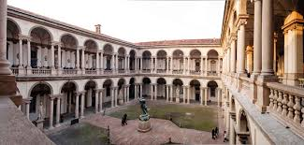
Multiple TOPIC Type: < Painting>; Dialogue Act: Overview
See example in
http://pinacotecabrera.org/en/collezione-online/opere/the-dead-christ-and-three-mourners/
Landmarks
Orientation Info
Visit Collection Events Education Calendar Support Us
Large animated image
Title :
Author :
Date:
Object Type and material:
Dimension:
Inventory Num:
Description: Max 200 words
You are in «Paintings of the Period X
Provenance
Structural links
About the author
Location: Room R
(see map)
Transition lins
NEXT / PREVIOUS Painting in Period X
Related Paintings in the same period
Related Paintings of the same author
Related Paintings of the same room
Group LInks

Slide 10
(Multiple) group name
< Fixed content: logo, payoff, banners… >
< Other Group links >
< Orientation info >
< Group name>
<Optional Introductory content >
Destination Page Preview + Group Link
Destination Page Preview + Group Link
< Landmarks >
Page structure in the small for a the Introductory Page of a (Multiple) Group

Slide 11
Group “Periods for Painting”
See example in
http://pinacotecabrera.org/en/collezioni/filter-collection/?filterby=periodi
Landmarks
Orientation Info
Visit Collection Events Education Calendar Support Us
Collection Online: Filter collection by Period/Era
Collection Title: The collection by Period
Image
2-3 Images
Period 1
Link to Group «Paintings of Period 1>
.
.
.
2-3 Images
Period N
Link to Group «Paintings of Period N>
.
Group LInks

Slide 12
Group “Paintings in Period X”
See example in
http://pinacotecabrera.org/en/collezioni/the-collection-online/?periodo=xv-secolo-d-c-en
Landmarks
Orientation Info
Visit Collection Events Education Calendar Support Us
Collection Online: Explore Paintings of Period X
Collection Title: The collection by Period
Image
Image
Title
Author
Link to Painting
.
.
.
Image
Title
Author
Link to Painting
Group LInks

Slide 13
< Relevant Relationship name
< Fixed content: logo, payoff, banners… >
< Landmarks >
Introductory content (optional)
Destination Page Preview + Semantic link (to the target of the relationship, i.e., the pages for the related topics)>
Destination Page Preview + Semantic link (to the target of the relationship, i.e., the pages for the related topics)>
Destination Page Preview + Semantic link (to the target of the relationship, i.e., the pages for the related topics)>
< Orientation info >
Semantic link (to the source of the relationship)
Page structure for a Transition Page

Slide 14
Transition Page “Paintings of Author A”
Landmarks
Orientation Info
Visit Collection Events Education Calendar Support Us
You are in paitings of author «A»
Author «A»: works at Brera
Image
Title
Link to Painting
.
.
.
Image
Title
Author
Link to Painting
Return to «A»
Transition LInks

Slide 15
Alternative representation of the in-the-small specifications
Using Tables
TOPIC/KIND OF TOPIC/ (MULTIPLE) GROUP NAME/ PAGE NAME
LANDMARKS
Landmark 1/label |  |  |  |  |  |  | Landmark N/Label
…
Structural/Semantic/Group Links
Structural/Semantic/Group Link 1/Label | Structural/Semantic/Group Link1/ Destination Preview (if needed) |  |  |  |  | Structural/Semantic/Group Link N/Label | Structural/Semantic/Group Link L/Destination Preview (if needed)
Main Content
Attribute 1 |  |  |  |  |  |  | Attribute M
Orientation Info

Slide 16
TOPIC/KIND OF TOPIC/ (MULTIPLE) GROUP NAME/ PAGE NAME
LANDMARKS
Landmark 1/label |  |  |  |  |  | Landmark N/Label
…
Structural/Semantic/Group Links
Structural/Semantic/Group Link 1/Label | Structural/Semantic/Group Link 1/Destination Preview (if needed) |  |  |  | Structural/Semantic/Group Link N/Label | Structural/Semantic/Group Link L/Destination Preview (if needed)
Main Content
Attribute 1 |  |  |  |  |  | Attribute M
Orientation Info

Slide 17
How to use the in-the-small specifications
To create page layouts («wireframes»)
Requirements for Front-End implementation
CSS definition – see future lessons
Requirements for Back-end implementation
Design of the back-end Data Base – see future lessons

Slide 18

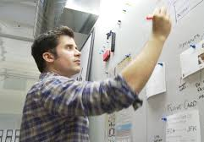



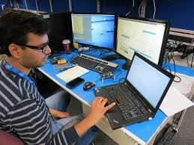
PROTOTYPING PROCESS
Build using Prototyping Tools
Build using implementation tools/sw frameworks
Semi-functional Prototype/Vertical
Semi-functional Prototype/Horizontal
Functional Prototype
FINAL PRODUCT
Sketches
Low fidelity wireframes
High fidelity wireframes
Interactive mockup
Used for requirements/design evaluation; promotion First step in the implementation process
Different professional profiles involved (designers….engineers)
Different technological tools

Slide 19
Sketches
Sometimes called “Paper based Prototyping”
Hand drafted examples of the interface (and possibly the flow of interaction)
You can use Sketches for your design in the small
Low fidelity / No interaction

Slide 20
Low/High Fidelity Wireframes
Fidelity: Distance from the final product
Low fidelity wireframes
also known as digital sketches or screen blueprints
focus on “what a screen offers, not what it looks like”
shows the basic visual organization of contents, navigation and interaction elements on the “screen”
High fidelity wireframes
define the advanced “look-and-feel” of the interface
show the visual organization of contents, navigation and interaction elements on the “screen” and define all their visual properties

Slide 21
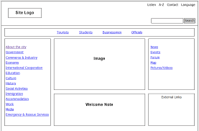
Low Fidelity Wireframe

Slide 22
Low Fidelity Wireframe
(Multiple) group name
< Fixed content: logo, payoff, banners… >
< Other Group links >
< Orientation info >
< Group name>
<Optional Introductory content >
Destination Page Preview + Group Link
Destination Page Preview + Group Link
< Landmarks >

Slide 23
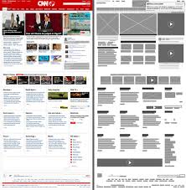
High Fidelity Wireframe
Medium
Fidelity Wireframe

Slide 24
Interactive mock-up
A set of interactive “screen shots” that:
Convey the «look and feel» of the interface and its main dynamic features
Enables to perform (examples of ) interaction i.e. navigation
a

Slide 25
Prototype
A system that provides part of the functionality of the final system
Implemented using (at least in part) the FINAL technology
Vertical Prototype: a SUBSET of FULLY implemented features & functions
Horizontal protoype = a COMPLETE SET of PARZIALLY IMPLEMENTED features & functions (e.g., omitting “background aspects such as ” DB connection”)
Functional prototype: provides all the functionality of the final product; needs a further step of engineering before final deployment

Slide 26
The good and the bad
Paper-based prototyping | Low-Fidelity Wireframes | High-Fidelity Wireframes | Interactive Mock-up | Functional prototype
PROS Quick and dirty Easy to do Fast feedback Very inclusive CONS Might be confused Hard to share | PROS Good for defining content and navigation structures, and evaluating them among design experts CONS No interactivity Limited specification of visual layout properties Enabling preliminary user testing only on structural aspects | PROS Detailed visual specs Good for defining and explain/validating content structure & LAYOUT CONS No interactivity Enabling preliminary user testing on lay-out and content aspects | PROS Good to explain BEHAVIORS and lively demonstrate scenarios Good for preliminary testing of navigation features CONS Time-consuming Development for a throw-away object | PROS Good for UX evaluation and technical testing VERTICAL: good for in- depth testing of tech features HORIZONTAL: good for full-sized UX evaluation CONS Requires software know-how VERTICAL: does not provides the full picture for the UX HORIZONTAL: technical problems of full-sized vertical functionaly may not be detected

Slide 27
Mockuping-Prototyping Tools
See also https://www.cooper.com/prototyping-tools
NAME | RUNS ON | PROTOTYPE FOR | OUTPUT | GESTURES | TRANSITIONS | DESIGN | TRIAL | PRICING
Antetype | OS X | Android, iOS, Web | HTML, iOS App Player | ✗ | ✗ | ✓ | 30 days | $189.99
App Cooker | iPad | iOS | PDF, App Player | ✓ | ✓ | ✓ | No | $19.99
Avocado | OS X | Android, iOS | Desktop | ✓ | ✓ | ✗ | Unlimited | Free
Axure | OS X, Windows | Any | HTML, PDF | ✗ | ✓ | ✓ | 30 days | From $289
Briefs | OS X | iOS | App Player | ✗ | ✓ | ✓ | Feature limited | $199
Codiqa Web | Web | Mobile | HTML | ✓ | ✗ | ✓ | Feature limited | From $16/mo.
Codiqa Desktop | OS X, Windows | Mobile | HTML | ✓ | ✗ | ✓ | 7 days | From $79
Concept.ly | Web | iPad, iPhone, Web | HTML | ✗ | ✗ | ✗ | No | From $0/mo.
Evolus Pencil | Linux, OS X, Windows | Any | HTML, PDF | ✗ | ✗ | ✓ | Unlimited | Free
Flinto | Web | Android, iOS | HTML | ✗ | ✓ | ✗ | 30 days | $20/mo.
Fluid UI | Web | Any | HTML, App Player | ✓ | ✓ | ✓ | Project limited | From $12/mo.
Form | OS X | iOS | App Player | ✓ | ✓ | ✗ | Unlimited | Free
Framer | OS X | Android, iOS | HTML | ✓ | ✓ | ✗ | 14 days | $79.99
Framework7 | Any (HTML) | iOS | HTML | ✓ | ✓ | ✓ | Unlimited | Free
Hotgloo | Web | Any | PDF | ✗ | ✗ | ✓ | 15 days | From €15/mo.
Indigo Studio | OS X, Windows | Any | HTML | ✓ | ✓ | ✓ | 30 days | From $1,495
InVision | Web | Android, iOS, Web | HTML | ✓ | ✓ | ✗ | No | From $0/mo.
Justinmind | OS X, Windows | Android, iOS, Web | HTML, App Player | ✓ | ✓ | ✓ | 30 days | From $29/mo.
Marvel | Web | Any | HTML | ✓ | ✓ | ✗ | Unlimited | Free
Marvel Apps | Android, iOS | Android, iOS | HTML, App Player | ✗ | ✓ | ✗ | Unlimited | Free
Moqups | Web | Any | HTML, PDF | ✗ | ✗ | ✓ | Project limited | From $9/mo.
Origami | OS X | Android, iOS | Desktop | ✓ | ✓ | ✗ | Unlimited | Free
Pidoco | Web | Any | HTML, PDF | ✓ | ✓ | ✓ | 31 days | From $12/mo.
Pixate | Web | Android, iOS | App Player | ✓ | ✗ | ✗ | No | From $0/mo.
POP | Android, iOS, WP | Android, iOS, WP | HTML, App Player | ✓ | ✓ | ✗ | Project limited | From $10/mo.
Proto.io | Web | Any | HTML, PDF, App Player | ✓ | ✓ | ✓ | 15 days | From $29/mo.
Protoshare | Web | Any | HTML | ✗ | ✗ | ✓ | 30 days | From $29/mo.
Prott | OS X, Web, Windows | Any | HTML | ✓ | ✓ | ✗ | Project limited | From $12/mo.
Prott App | iOS | iOS | HTML, App Player | ✓ | ✓ | ✗ | Unlimited | Free
Ratchet | Any (HTML) | Android, iOS | HTML | ✗ | ✓ | ✓ | Unlimited | Free
Solidify | Web | Any | HTML | ✗ | ✓ | ✗ | 30 days | From $19/mo.
UXPin | Web | Any | HTML, PDF | ✗ | ✓ | ✓ | 30 days | From $15/mo.
Weld | Web | Any | HTML | ✗ | ✓ | ✓ | No | From $0/mo.

Slide 28
Mockupping/Prototyping Tools: what do they have in common
Template specific for different devices and platforms
Drag-and-drop elements to compose pages
Export project in different formats (Pdf, Png,..)
Navigate among the project’s pages
Share project with client
Collect feedback and annotation
Add tasks for project members

Slide 29
Examples of mock-upping tools

Slide 30
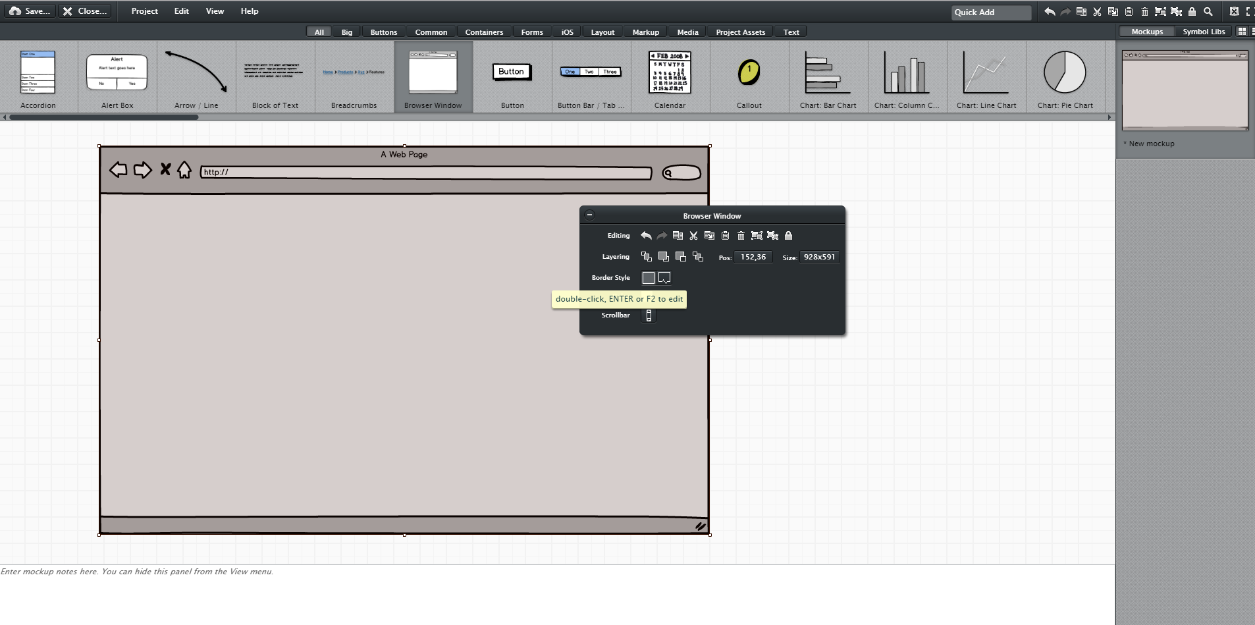
Balsamiq: (https://balsamiq.com/)

Slide 31
Balsamiq: (https://balsamiq.com/)
Pro
Easy to use
A big set of pre-defined elements
Import/Export functions
Interactive pdf downloadable
Collaborative working
Web editor + Desktop app
Con
Free-trial: 30 days

Slide 32
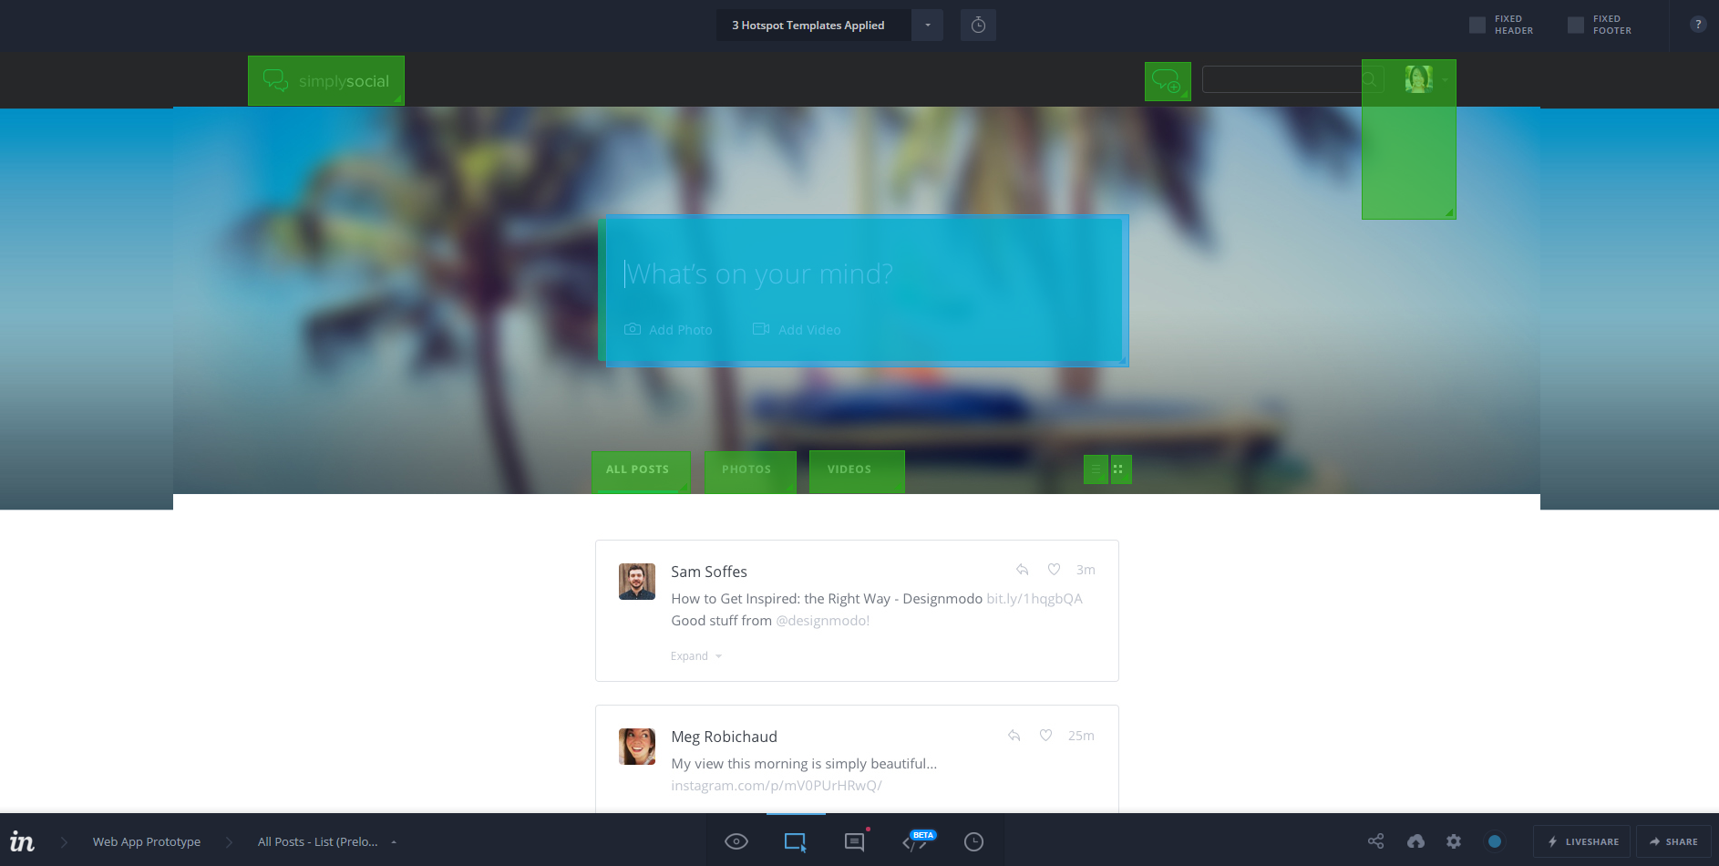
InVision: (https://www.invisionapp.com/)

Slide 33
InVision: (https://www.invisionapp.com/)
Pro:
Easy to use (drag and drop to add screens and create hotspot)
Sharing and commenting system for collecting feedback
Support for mobile/touch gestures
Workflow + Map visualization
Web editor
Con:
Only good for working with existing mocks; No features for creating or modifying elements in the tool
Interactivity limited to hotspots or timeouts for moving between screens

Slide 34
What do you have to do in your «Design and Front end» project
Taking into account the general requirements of the projects:
Create the C-IDM schema, L-IDM schema, and P-IDM schema (be consistent!)
Create in-the-small design specifications (as hand-drafted “sketches” or “low-fidelity” wireframes) CONSISTENT with IDM specifications
Create a vertical prototype that enables to perform the main navigation steps (be consistent with the IDM schema and in-the-small specifications!)
Evaluate you protype with a sample of users
INCLUDE REALISTIC CONTENT IN YOU PROTOTYPE!

Slide 35
Project Topic
The web site for a center devoted to offer assistance and therapeutic intervention to children and/or young adults with cognitive disability
Examples:
http://labilita.org/
http://www.benedettadintino.it/
Find others!

